Slide 1


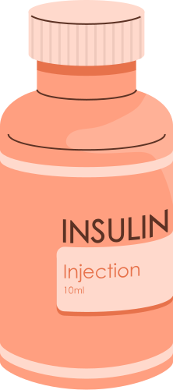
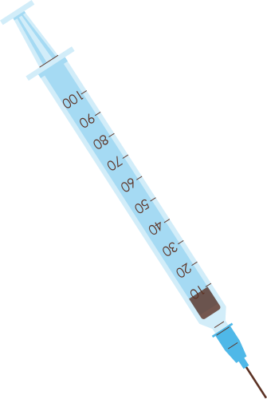


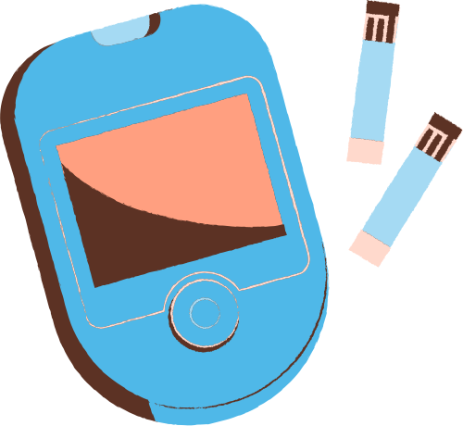
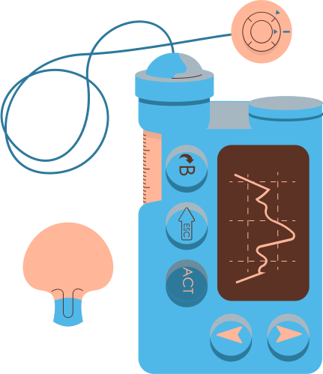
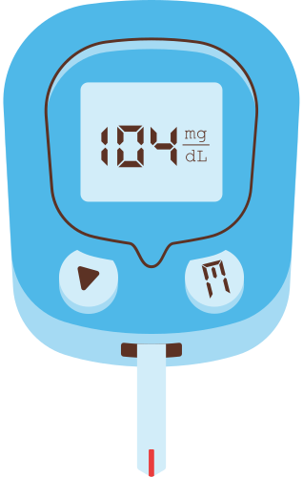

TEAM C21
BIG DATA ANALYTICS IN DIABETIC MANAGEMENT SYSTEM
Guide: M.Neelakantappa
Team Members
C.Shreya Sree :1602-21-737-177
A.Hasitha :1602-21-737-315

Slide 2

ABSTRACT
1. The study aims to predict diabetes status using machine learning (ML) and deep learning (DL) models on the BRFSS 2021 dataset.
2. The dataset includes health indicators like BMI, physical activity, and general health, with the target variable `Diabetes_012` classified into three categories: 0 (No Diabetes), 1 (Pre-diabetes), and 2 (Diabetes).
3. Data preprocessing involved handling missing values, feature-target separation, encoding, and an 80:20 train-test split.
4. Traditional ML models used include Decision Tree, Random Forest, Gradient Boosting, Logistic Regression, and Naive Bayes, evaluated using accuracy, confusion matrices, and ROC-AUC scores with One-vs-Rest strategy.
5. A deep learning model (ANN) was built using Keras, with two hidden layers and softmax output, optimized using Adam and early stopping.
6. Random Forest, Gradient Boosting, and ANN achieved high accuracy, proving the value of ML/DL in early diabetes prediction and real-world healthcare applications.

Slide 3
PROBLEM STATEMENT
Diabetes management is complicated by the massive volume and complexity of healthcare data generated daily.
Traditional methods are inadequate for timely diagnosis and personalized treatment due to limited data processing capabilities.
There's a critical need for scalable, efficient systems that can handle large and diverse datasets.
This project leverages Big Data Analytics (BDA) and Machine Learning (ML) to address these limitations.
The goal is to enable early diabetes detection, personalized patient care, and improved clinical outcomes.
The approach also considers key challenges like data privacy and system scalability in healthcare environments.

Slide 4
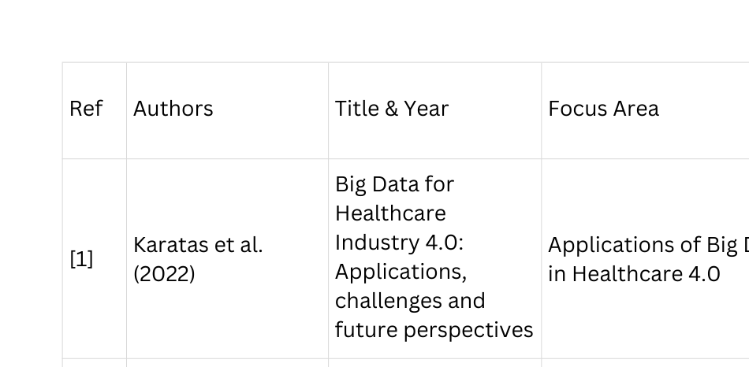
LITERATURE SURVEY

Slide 5
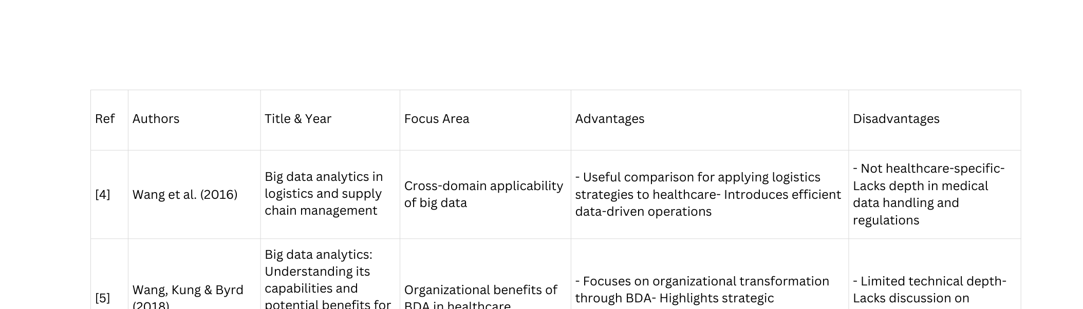
LITERATURE SURVEY

Slide 6
PROPOSED METHODOLOGY
Random Forest: An ensemble learning method using multiple decision trees for classification/regression, improving accuracy and reducing overfitting through averaging.
Decision Tree: A tree-like model that splits data based on feature conditions, used for classification and regression with interpretable decision-making.
Gradient Boosting Machine (GBM): A sequential ensemble method that builds trees iteratively, optimizing predictions by minimizing errors using gradient descent techniques.

Slide 7
PROPOSED METHODOLOGY
Logistic Regression: A binary classification algorithm that uses the sigmoid function to predict the probability of an outcome (e.g., diabetic vs. non-diabetic).
Naive Bayes: A probabilistic classifier based on Bayes' theorem, assuming feature independence, often used for medical diagnosis
Artificial Neural Networks (ANNs): A deep learning model with input, hidden, and output layers, mimicking human brain function for complex pattern recognition.

Slide 8
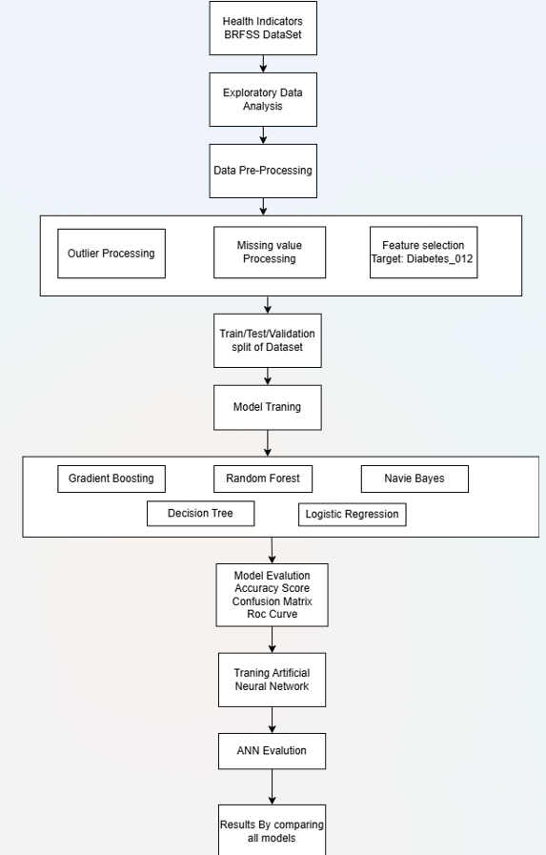
ARCHITECTURE DIAGRAM

Slide 9
EXPERIMENTAL SETUP
DESCRIPTION
HARDWARE REQUIREMENTS
• MINIMUM REQUIREMENTS:
CPU - 4CORES
RAM - 8GB RAM
• RECOMMENDED REQUIREMENTS:
RAM - 16GB RAM
CPU - INTEL CORE I7/ AMD RYZEN
GPU - NVIDIA 2GB
SOFTWARE REQUIREMENTS
PYTHON : 3.10+
TENSORFLOW / KERAS :2.10+
NUMPY : 1.24+
PANDAS : 2.0+
SCIKIT-LEARN : 1.2+
MATPLOTLIB: FOR VISUALIZATIONS
STREAMLIT : FOR USER-INTERFACE

Slide 10
DATASET DESCRIPTION
DIABETES 012 HEALTH INDICATORS BRFSS
2021
SOURCE:
BEHAVIORAL RISK FACTOR SURVEILLANCE
SYSTEM(BRFSS), 2021
• FILE NAME:
‘DIABETES 012 HEALTH INDICATORS
BRFSS2021.CSV‘
• TARGET VARIABLE:
‘DIABETES 012‘
– ‘0‘ - NO DIABETES
– ‘1‘ - PRE-DIABETES
– ‘2‘ - DIABETES
• NUMBER OF RECORDS (ROWS):
236,378
• NUMBER OF FEATURES (COLUMNS):
22 (BEFORE PREPROCESSING)
• DATASET SIZE:APPROXIMATELY
35 MB

Slide 11
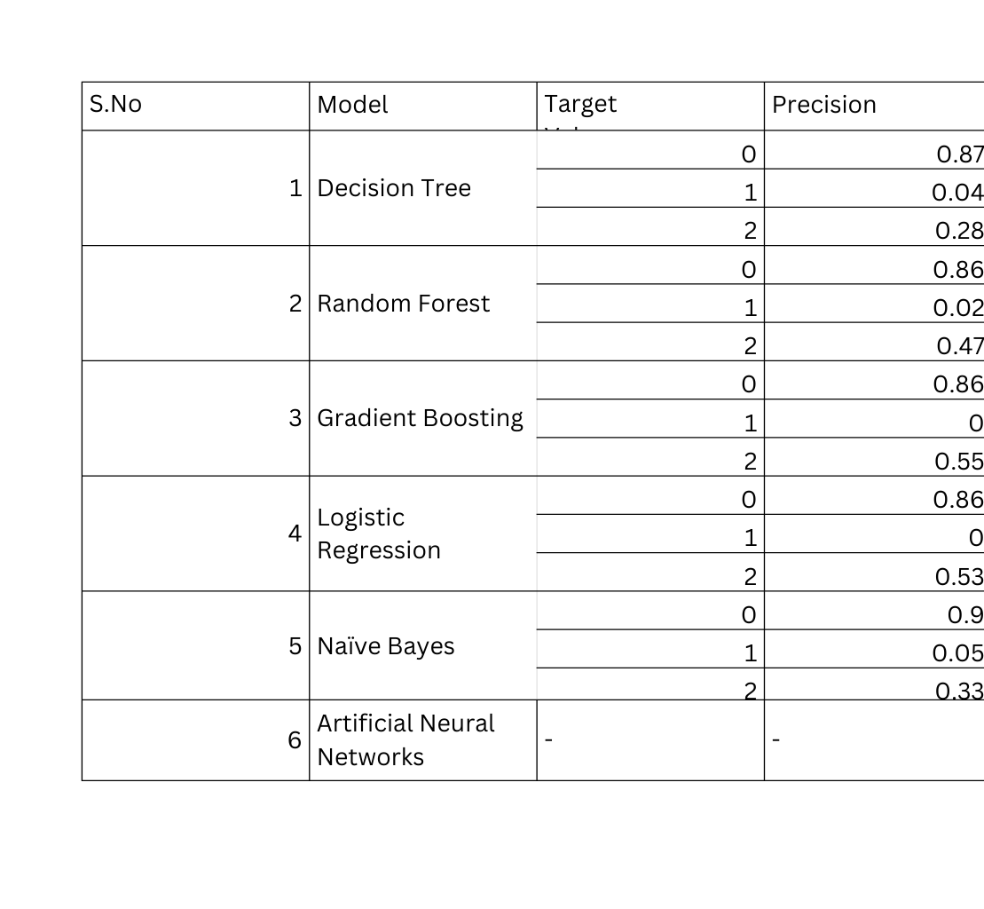
Evaluation Metrics

Slide 12
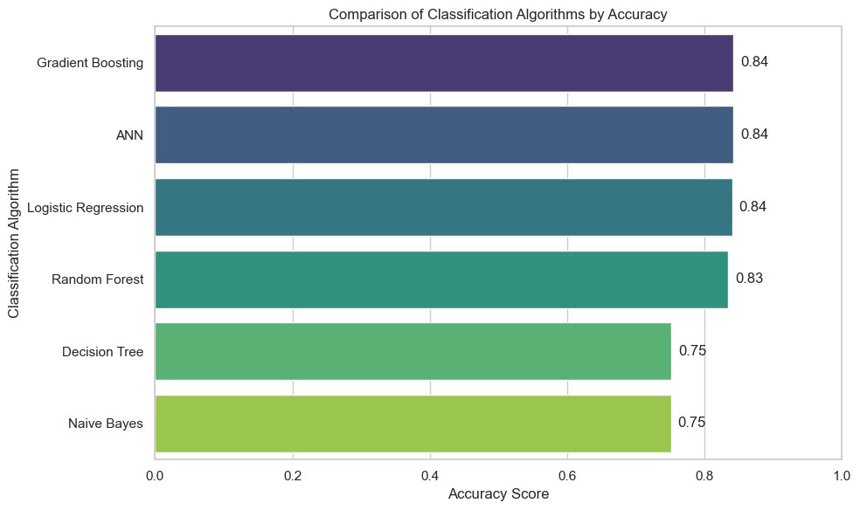
Results

Slide 13
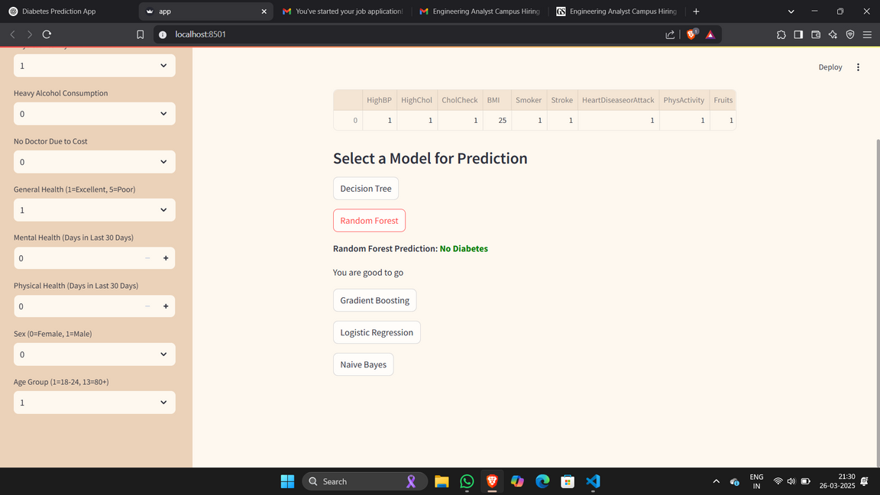
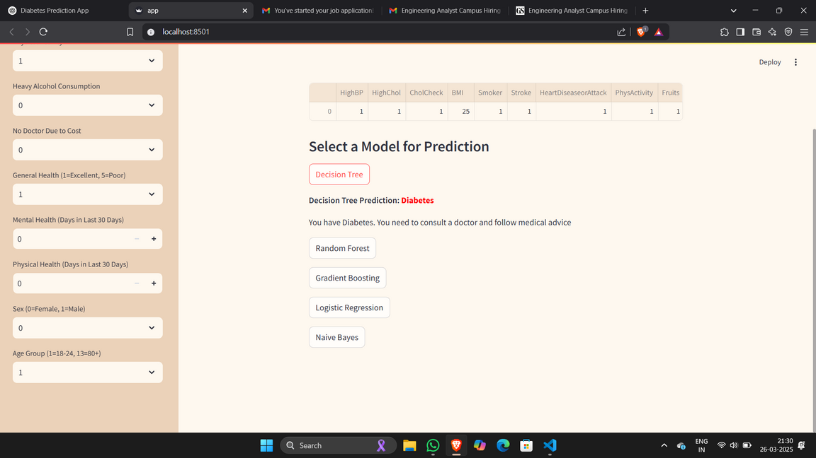
Results
NO DIABETIES
DIABETIES

Slide 14
Conclusion
ML and DL models can effectively predict diabetes status.
Random Forest, Gradient Boosting, and ANN were top performers.
BDA enables proactive healthcare and risk assessment.
Accurate predictions aid early intervention and reduce costs.

Slide 15
Future Scope
Use additional datasets for cross-population generalization.
Integrate real-time streaming data from IoT devices.
Expand to include other diseases (hypertension, heart disease).
Explore federated learning for privacy-preserving analytics.
Improve explainability using SHAP or LIME.

Slide 16
REFERENCES
[1] KARATAS, MUMTAZ, ET AL. "BIG DATA FOR HEALTHCARE INDUSTRY 4.0: APPLICATIONS, CHALLENGES AND FUTURE PERSPECTIVES." EXPERT SYSTEMS WITH APPLICATIONS 200 (2022): 116912.
[2] PALANISAMY, VENKETESH, AND RAMKUMAR THIRUNAVUKARASU. "IMPLICATIONS OF BIG DATA ANALYTICS IN DEVELOPING HEALTHCARE FRAMEWORKS–A REVIEW." JOURNAL OF KING SAUD UNIVERSITY-COMPUTER AND INFORMATION SCIENCES 31.4 (2019): 415-425.
[3] NAZIR, SHAH,ET AL. "A COMPREHENSIVE ANALYSISOF HEALTHCARE BIG DATA MANAGEMENT, ANALYTICS AND SCIENTIFIC PROGRAMMING." IEEE ACCESS 8 (2020): 95714-95733.
[4] WANG, GANG, ET AL. "BIG DATA ANALYTICS IN LOGISTICS AND SUPPLY CHAIN MANAGEMENT: CERTAIN INVESTIGATIONS FOR RESEARCH AND APPLICATIONS." INTERNATIONAL JOURNAL OF PRODUCTION ECONOMICS 176 (2016): 98-110.
[5] WANG, YICHUAN, LEEANN KUNG, AND TERRY ANTHONY BYRD. "BIG DATA ANALYTICS: UNDERSTANDING ITS CAPABILITIES AND POTENTIAL BENEFITS FOR HEALTHCARE ORGANIZATIONS." TECHNOLOGICAL FORECASTING AND SOCIAL CHANGE 126 (2018): 3-13.

Slide 17
PUBLICATION STATUS AND DETAILS:
A research paper based on this project has been submitted to the 2025 IEEE International Conference on Quantum Photonics, Artificial Intelligence, and Networking. The paper is currently under review

Slide 18

THANK YOU!

